Slide 1


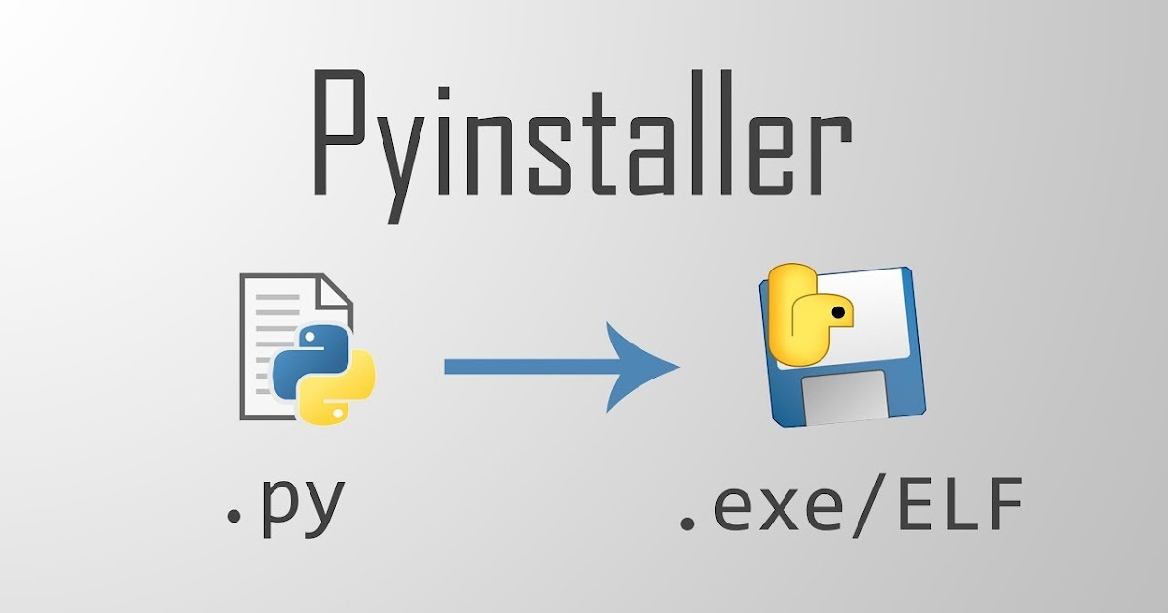
Python File to exe File Using pyinstaller

Slide 2
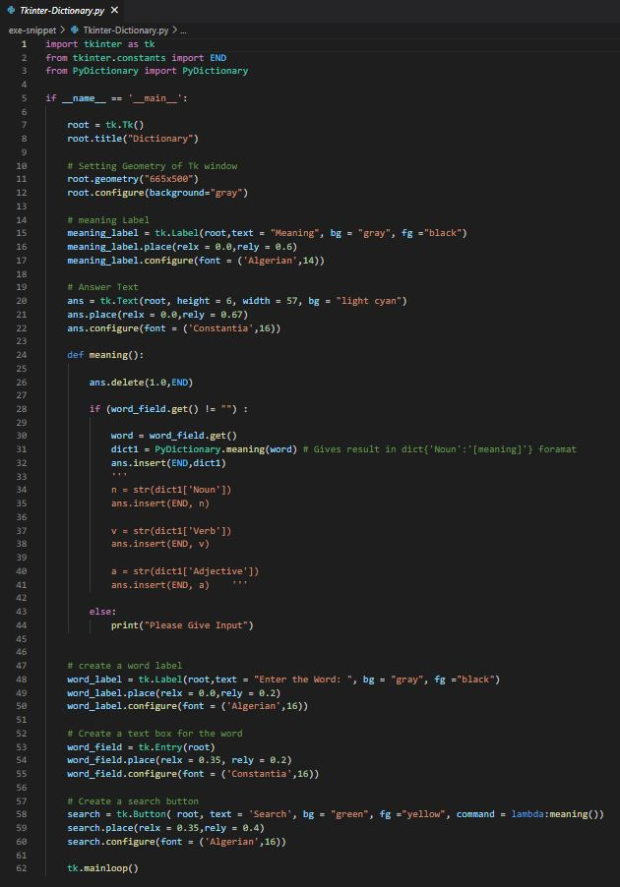
.py to .exe
Python program must be a GUI snippet (tkinter)
GUI Snippet for getting meaning of the word like a dictionary using pydictionary <pip install PyDictionary>
This Python code file name --> Tkinter-Dictionary.py
Convert this python program into exe file by using python installer <pip install pyinstaller>
Open Command Prompt from the location of this python file
Run this cmd pyinstaller --onefile -w <PythonFileName.py>
pyinstaller --onefile -w Tkinter-Dictionary.py

Slide 3
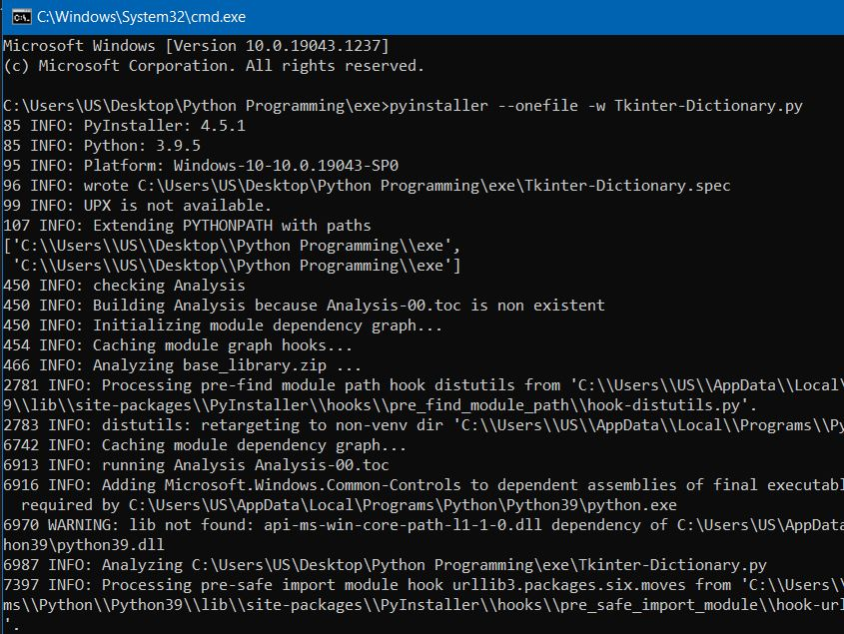
Command Prompt -->

Slide 4
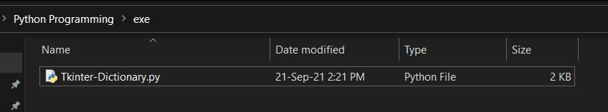
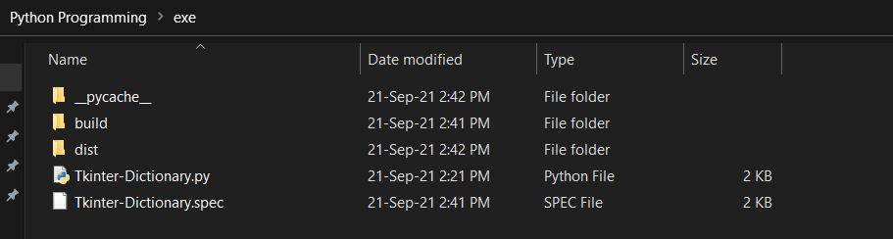
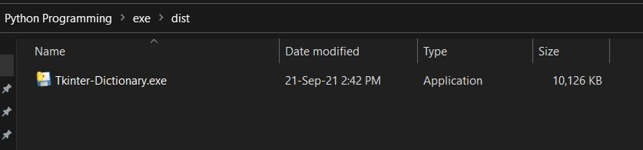
Before run pyinstaller -->
After run pyinstaller -->
Folder dist contain -->

Slide 5
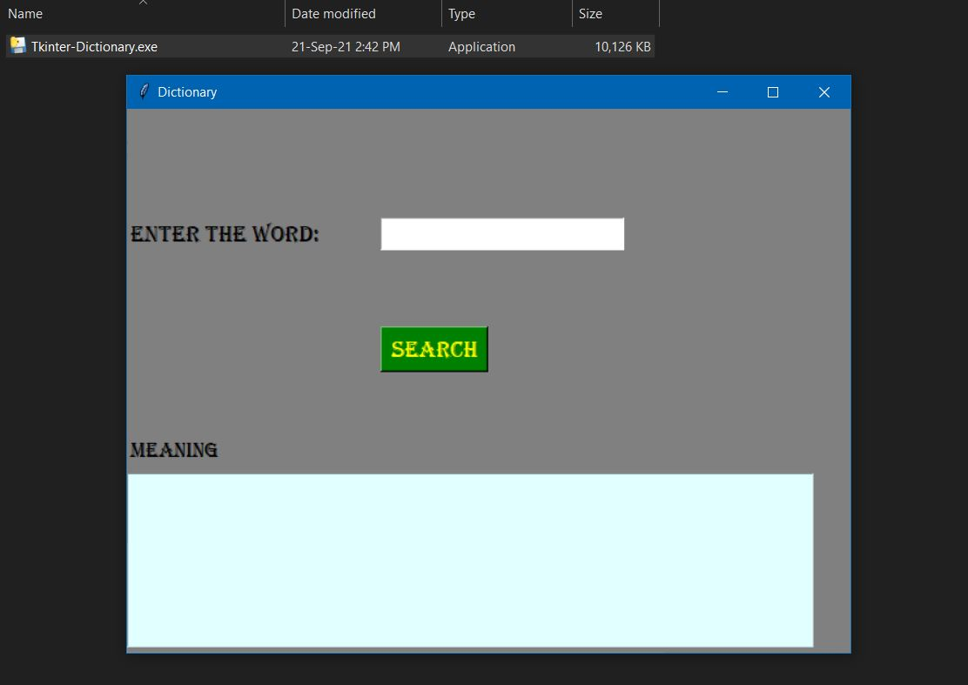
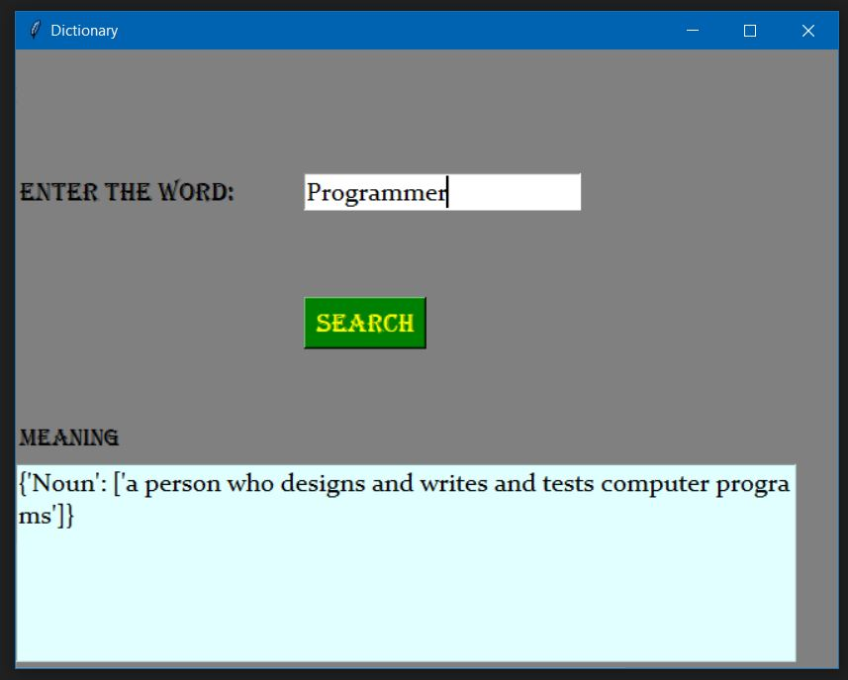
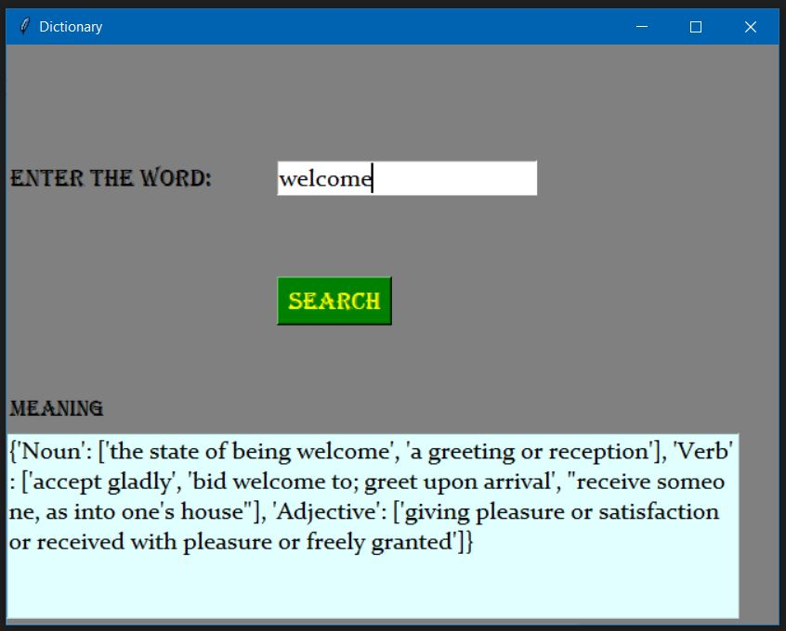
Output
Open Tkinter-Dictionary.exe file -->

